Slide 1

Wangard & Reinders Family Multi-Family Development
Plan Commission Meeting
Conceptual Review
March 7, 2016

Slide 2
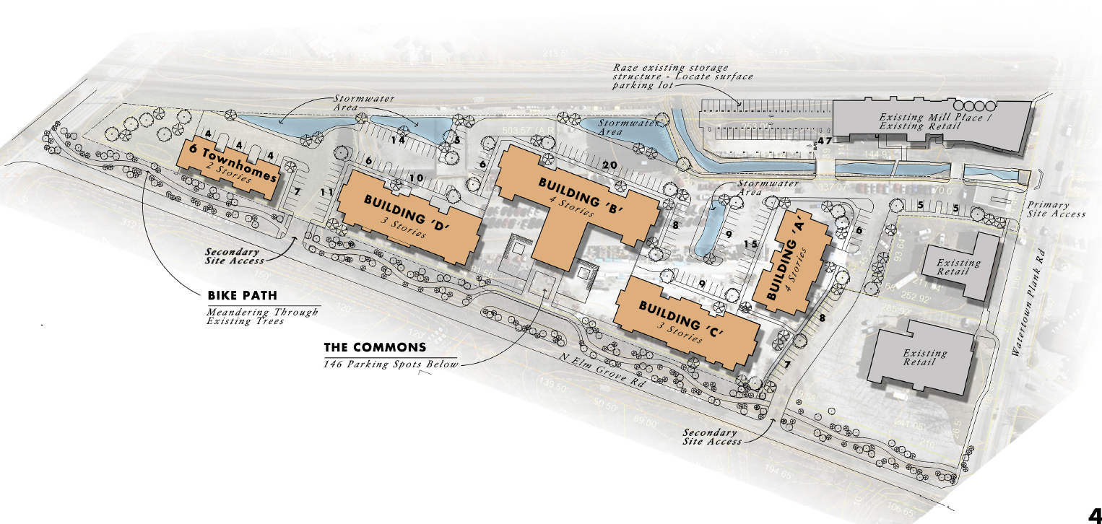
Future Proposed

Slide 3
Project Summary
Units: 182 Total
Unit Type Avg Unit SF
Studio 560
1BR - Traditional 642
1BR - Standard 747
1BR - Deluxe 838
1BR Den 978
2BR, 2BA - Corner 2 1,132
2BR, 2BA - Corner 1,217
2BR, 2BA - Corner Deluxe 1,258
2BR, 2BA Den 1,372
2BR Townhome 2,076
3BR Townhome 2,306
Parking: 402 Total Spaces (2.2 parking ratio)
238 enclosed (1.30 parking ratio)
164 surface

Slide 4
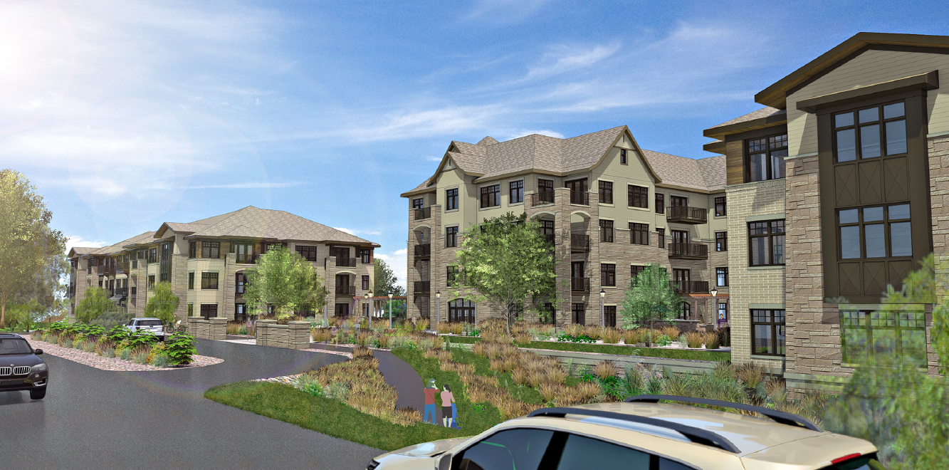

Slide 5
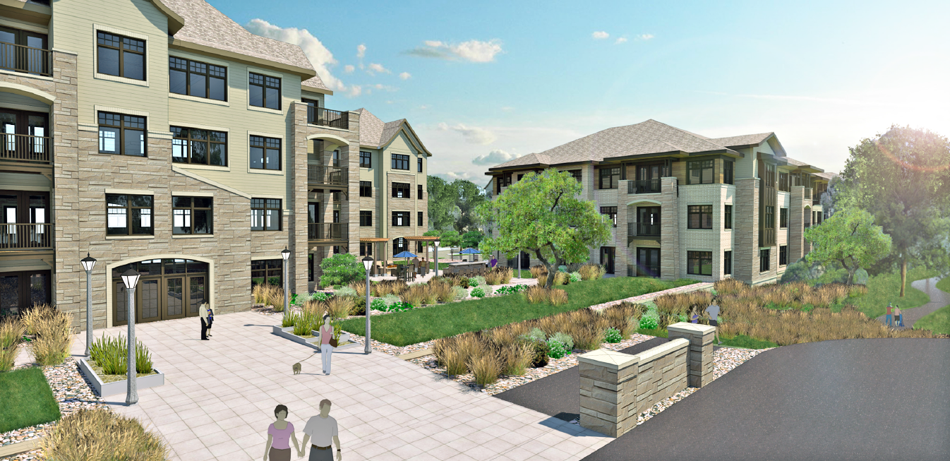

Slide 6
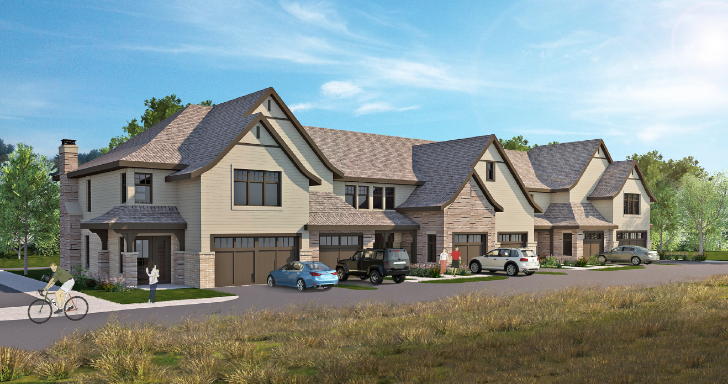

Slide 7
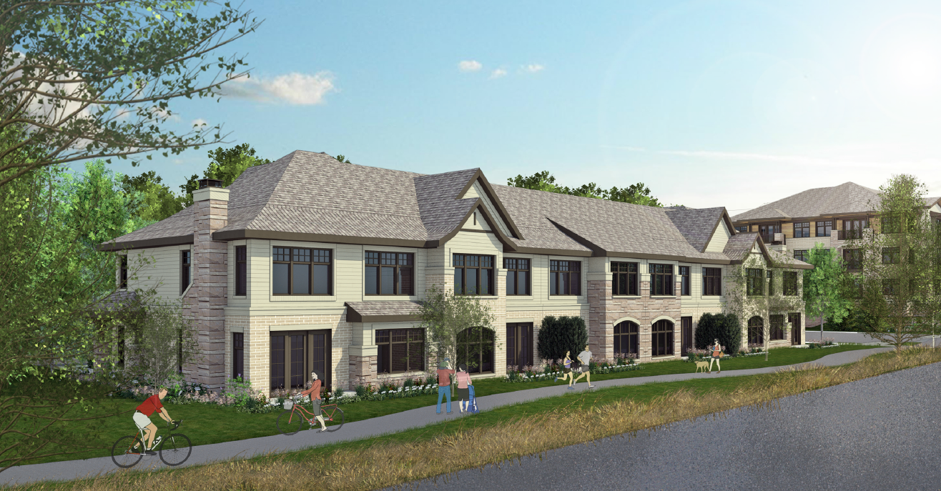

Slide 8
Density
22 Units/ Acre
Better utilizes land and preserves natural resources
Development of site includes soil management, clean-up and cap and prevents contamination from leaving the site and entering local waterways
Stormwater management system will help local Underwood Creek
Structures, workmanship and features are of the highest quality design – the architecture of the neighborhood was incorporated into the design
Project will upgrade public infrastructure by extending a water main down Watertown Plank road and through the site

Slide 9
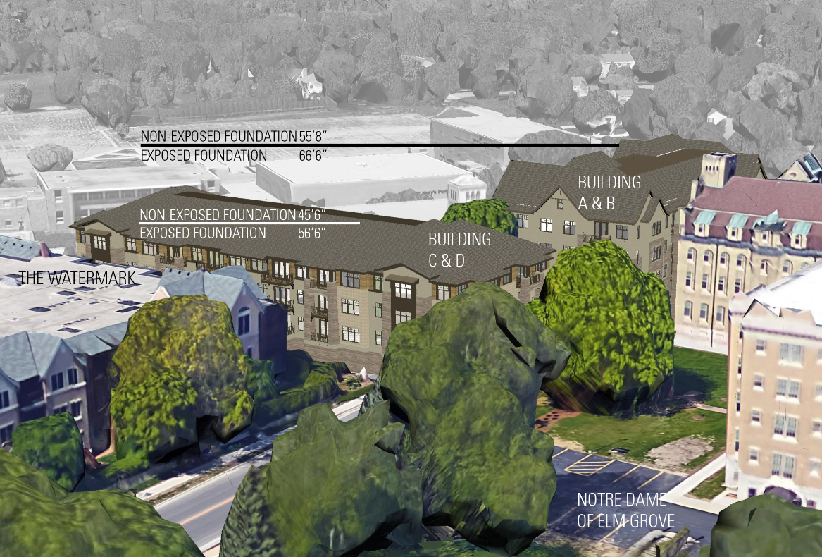
Building Heights
Building A&B
4 story side (w/ exposed lower level): 66 ft, 6in
4 story side (non exposed lower level): 55ft, 8 in
Building C&D
3 story side (w/ exposed lower level): 56 ft, 6in
3 story side (non-exposed lower level): 45 ft, 6in
Townhomes
2 story: 32 ft, 10 in

Slide 10
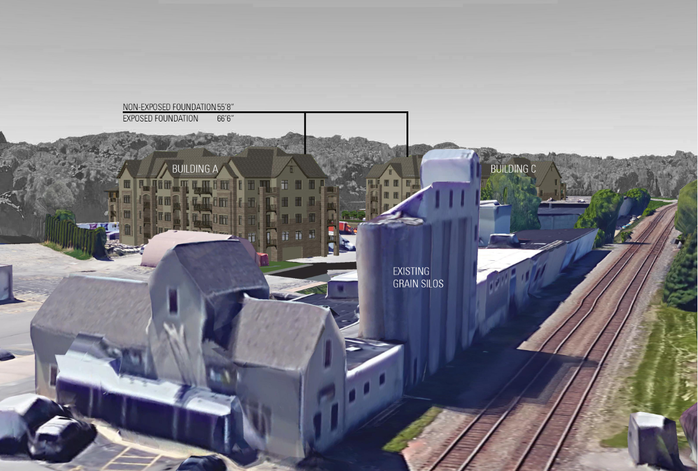

Slide 11
Traffic Impact Analysis

Slide 12
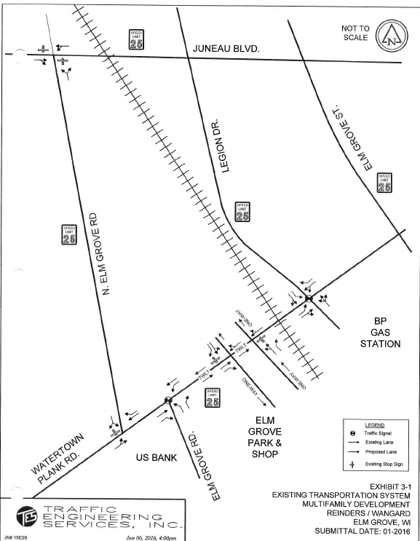

Slide 13
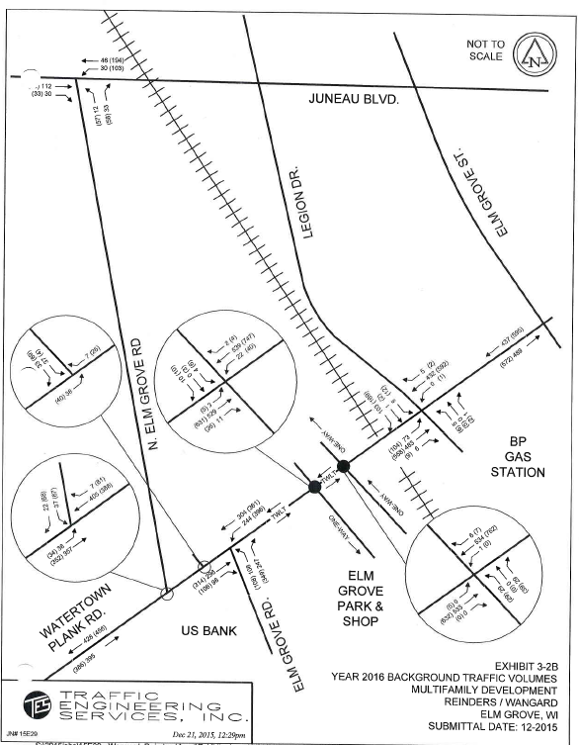

Slide 14
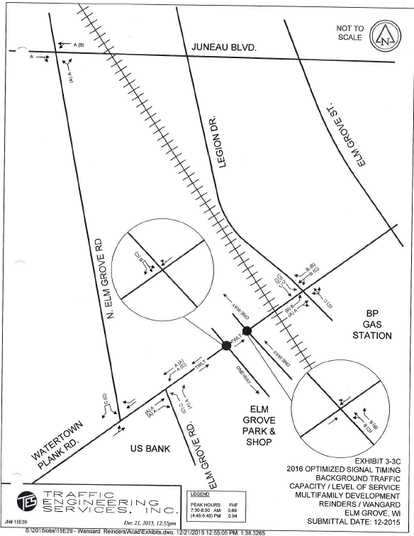

Slide 15
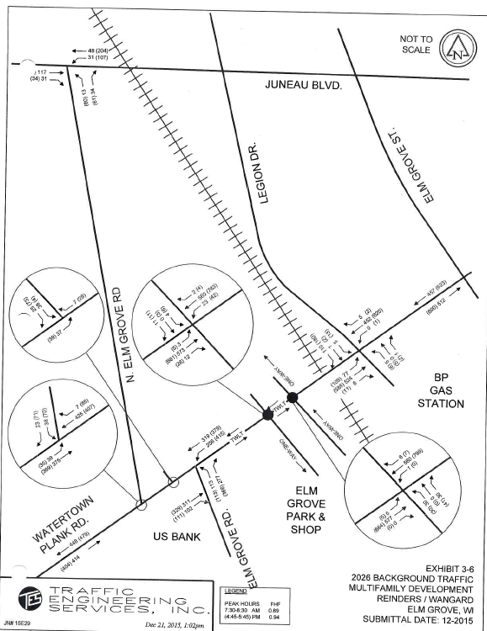

Slide 16
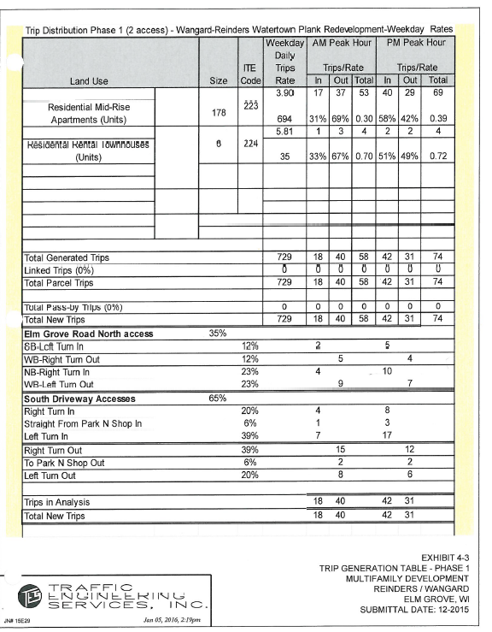

Slide 17
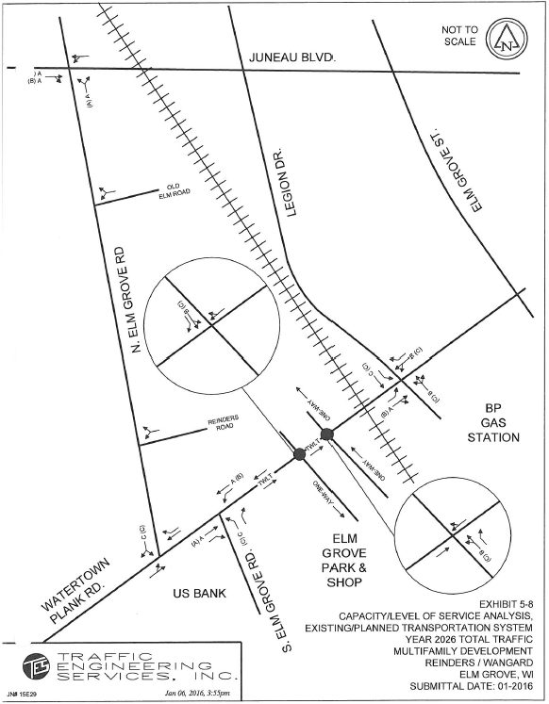

Slide 18
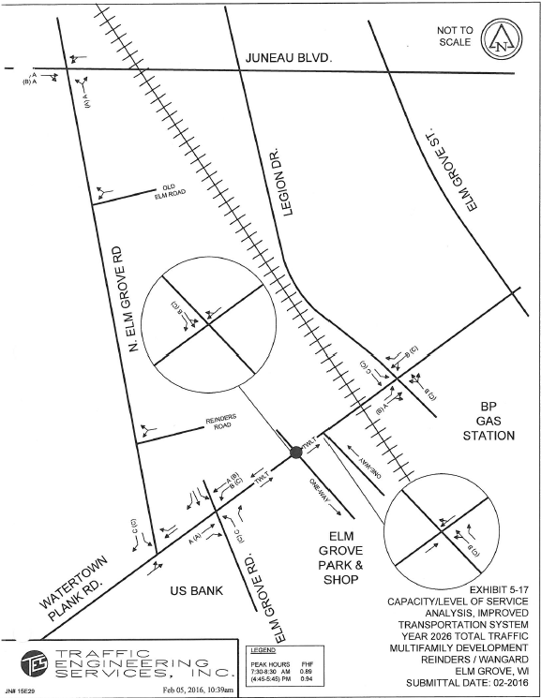

Slide 19
Tax Increment Financing
Why is it needed?
Site Clearing and Demolition
Watermain Extension
Environmental
Site Investigation
Pre-Demo Inspection and Abatement
Earthwork, Excavation, Trucking, Disposal
Paving / Concrete as Cap Barrier on Contaminated Soil
Clean Cap on Green Spaces
Under Slab Ventilation System
Stormwater Management
Extraordinary Construction due to Geotechnical Conditions
Incremental Cost of Underground Parking
Project poses a significant benefit to the businesses and residents in Elm Grove
Eliminates blight
Provides increase in population that is within walking distance of the shops in the village
Improves environmental conditions on site – environmental remediation & stormwater management
Extends municipal water main which will also provide opportunity for service to other properties in the village center area

Slide 20
